Slide 1
Module 8: Implementing Inter-VLAN Routing
CCNP SWITCH: Implementing IP Switching
Notes:
Cisco Networking Academy Program
CCNP SWITCH: Implementing IP Switching
Chapter 4: Implementing Inter-VLAN Routing

Slide 2
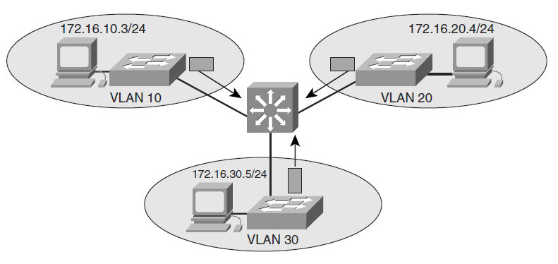
Inter-VLAN Routing Options
External router with a separate interface for each VLAN.
External router trunked to Layer 2 switch (router-on-a-stick).
Multilayer switch (pictured).
Notes:
Adding an external router with an individual interface in each VLAN is a nonscalable solution, especially when between 20 and 50 VLANs exist in the network. In addition, adding an external router for inter-VLAN routing on trunk interfaces does not scale beyond 50 VLANs. This chapter discusses only using Layer 3 switches and external routers with trunk interfaces (router-on-a-stick) to route VLANs. Furthermore, Cisco IOS routers support trunking in specific Cisco IOS Software feature sets, such as the IP Plus Feature set. Refer to the documentation on Cisco.com for software requirements before deploying inter-VLAN routing on Cisco IOS routers.
Router-on-a-stick is simple to implement because routers are usually available in every network, but most enterprise networks use multilayer switches to achieve high packet processing rates using hardware switching. In addition, Layer 3 switches usually have packet-switching throughputs in the millions of packets per second (pps), whereas traditional general-purpose routers provide packet switching in the range of 100,000 pps to more than 1 million pps. Router-on-a-stick in modern networking is mostly useful as a means of explaining inter-VLAN routing operation.

Slide 3
Catalyst Switch Layer 3 Interfaces
Routed port: A pure Layer 3 interface similar to a routed port on a Cisco IOS router.
Switch virtual interface (SVI): A virtual VLAN interface for inter-VLAN routing. In other words, SVIs are virtual routed VLAN interfaces.
Notes:
Because of high-performance switches such as the Catalyst 6500 and Catalyst 4500, almost every function, from spanning tree to routing, is done through hardware switching using features such as MLS and Cisco Express Forwarding (CEF)-based MLS, both of which are discussed in detail in later sections of this chapter. All Layer 3 Cisco Catalyst switches support routing protocols, but several models of Catalyst switches require enhanced software for specific routing protocol features.

Slide 4
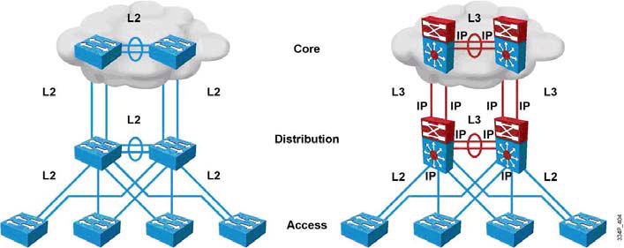
Routed/L3-Switched vs. L2 Switched Design
Routing can now be performed at L2 switching speeds by switching frames/packets using specialized hardware circuits.
L3 switches serve as default gateways, terminating VLANs (one IP subnet per VLAN).
Notes:
In the early days of switched networks, switching was fast (often at hardware speed) and routing was slow (routing had to be processed in software). This prompted network designers to extend the switched part of the network as much as possible. Access, distribution, and core layers were often partly configured to communicate at Layer 2. This architecture is referred as switched, as shown in the figure. This topology created loop issues. To solve these issues, spanning-tree technologies were used to prevent loops while still enabling flexibility and redundancy in inter-switch connections.
As network technologies evolved, routing became faster and cheaper. Today, routing can be performed at hardware speed. One consequence of this evolution is that routing can be brought down to the core and the distribution layers without impacting network performance. As many users are in separate VLANs, and as each VLAN is usually a separate subnet, it is logical to configure the distribution switches as Layer 3 gateways for the users of each access switch VLAN. This implies that each distribution switch must have IP addresses matching each access switch VLAN. This architecture is referred to as routed, as shown in the figure.
Implement L3 ports instead of L2 ports between the distribution and the core layer. Because dynamic routing protocols can dynamically adapt to any change in the network topology, this new topology also eliminates Layer 2 loops. Between access and distribution switches, where Layer 2 connections remain, Flex Link technology can be used to activate only one link at a time or Layer 2 EtherChannel can be used, thus removing the risk of loops and the need for spanning tree.

Slide 5
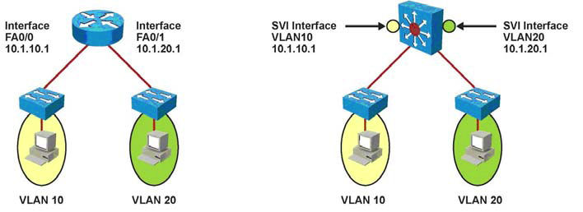
Switch Virtual Interfaces (SVI’s)
Configured on multilayer switches, one per VLAN.
The management interface on an L2 switch is an SVI, but an L2 switch is limited to one active SVI.
An SVI associates with an L2 VLAN – a switch must have an active L2 instance of a VLAN in order for an (L3) SVI to function.
Notes:
An SVI is a virtual interface configured within a multilayer switch compared to external router configuration where the trunk is needed. An SVI can be created for any VLAN that exists on the switch. Only one VLAN associates with one SVI. An SVI is “virtual” in that there is no physical port dedicated to the interface, yet it can perform the same functions for the VLAN as a router interface would and can be configured in much the same way as a router interface (IP address, inbound/outbound ACLs, and so on). The SVI for the VLAN provides Layer 3 processing for packets to or from all switch ports associated with that VLAN.
By default, an SVI is created for the default VLAN (VLAN1) to permit remote switch administration. Additional SVIs must be explicitly created. SVIs are created the first time the VLAN interface configuration mode is entered for a particular VLAN SVI (for instance, when the command interface vlan # is entered). The VLAN number used corresponds to the VLAN tag associated with data frames on an 802.1Q encapsulated trunk or to the VLAN ID (VID) configured for an access port. For instance, if creating an SVI as a gateway for VLAN 10, name the SVI interface VLAN 10. Configure and assign an IP address to each VLAN SVI that is to route traffic off of and onto a VLAN. Whenever the SVI is created, make sure that particular VLAN is present in the VLAN database manually or learned via VTP. As shown in the figure, the switch should have VLAN 10 and VLAN 20 present in the VLAN database; otherwise, the SVI interface will stay down.
The following are some of the reasons to configure SVI:
To provide a gateway for a VLAN so that traffic can be routed into or out of that VLAN
To provide fallback bridging if it is required for non-routable protocols Note Using fallback bridging, non-IP packets can be forwarded across the routed interfaces, but this course focuses only on inter-VLAN routing, so only IP connectivity is discussed.
To provide Layer 3 IP connectivity to the switch
To support routing protocol and bridging configurations
SVI: Advantages and Disadvantages
The following are some of the advantage of SVI:
It is much faster than router-on-a-stick because everything is hardware switched and routed.
No need for external links from the switch to the router for routing.
Not limited to one link., Layer 2 EtherChannels can be used between the switches to get more bandwidth.
Latency is much lower because it doesn’t need to leave the switch.
The following is a disadvantage:
It needs a Layer 3 switch to perform Inter-VLAN routing, which is more expensive.

Slide 6
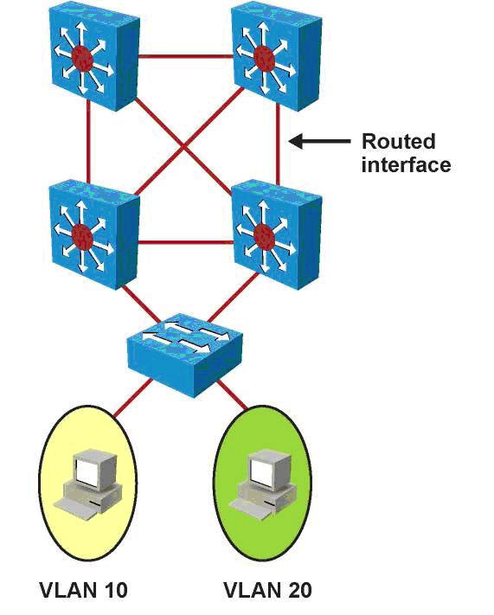
Routed Ports
Use the no switchport command to configure a physical switch port as a routed port.
Routed ports are used in conjunction with SVI’s.
Routed ports connect point-to-point (L3) links between distribution layer and core layer switches.
A 48-port L3 switch can be configured as a 48-port router.
Notes:
A routed port is a physical port that acts similarly to a port on a traditional router with Layer 3 addresses configured. Unlike an access port, a routed port is not associated with a particular VLAN. A routed port behaves like a regular router interface. Also, because Layer 2 functionality has been removed, Layer 2 protocols, such as STP and VTP, do not function on a routed interface. However, protocols such as LACP, which can be used to build either Layer 2 or Layer 3 EtherChannel bundles, would still function at Layer 3. Routed interfaces don’t support subinterfaces as with Cisco IOS routers. Routed ports are used for point-to-point links; connecting WAN routers and security devices are examples of the use of routed ports. In the campus switched network, routed ports are mostly configured between the switches in the campus backbone and between switches in the campus backbone and building distribution switches if Layer 3 routing is applied in the distribution layer. The figure illustrates routed ports for point-to-point links in a campus switched network.
To configure routed ports, make sure to configure the respective interface as a Layer 3 interface using the no switchport interface command, if the default configurations of the interfaces are Layer 2 interfaces as with the Catalyst 3560 family of switches. In addition, assign an IP address and other Layer 3 parameters as necessary. After assigning the IP address, make certain that IP routing is globally enabled and that applicable routing protocols are configured. The number of routed ports and SVIs that can be configured on a switch is not limited by software. However, the interrelationship between these interfaces and other features configured on the switch may overload the CPU due to hardware limitations, so a network engineer should fully consider these limits before configuring these features on numerous interfaces.
Following are some of the advantages of routed ports:
A multilayer switch can have SVIs and routed ports on a single switch.
Multilayer switches forward either Layer 2 or Layer 3 traffic in hardware.

Slide 7
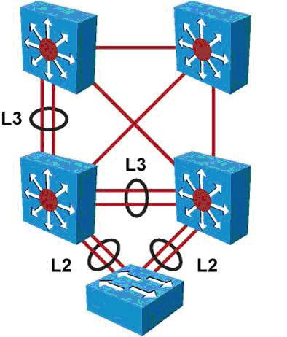
L3 EtherChannels
Just as with physical interfaces on multilayer switches, bundles of interfaces (port channels) can be configured as routed ports.
Port channels configured as routed ports are called L3 EtherChannels.
L2 EtherChannels are normally used only when connecting from an access layer switch.
Notes:
The EtherChannel technology is available to bundle ports of the same type. On a Layer 2 switch, EtherChannel can aggregate access ports such as servers that support EtherChannel or trunk links to connect switches. As each EtherChannel link is seen as one logical connection, ports that are member of an EtherChannel can load balance traffic on all the links that are up. On Layer 3 switches, switched ports can be converted to routed ports. These ports do not perform switching at Layer 2 anymore, but become Layer 3 ports similar to those found on router platforms. Routed Layer 3 ports can also form EtherChannel just like Layer 2. On a multilayer switch, it is easy to configure Layer 2 EtherChannels or Layer 3 EtherChannels, depending on what type of devices connect and depending on their position in the network. The configuration requires that ports on both sides are configured the same way: switch ports (access or trunk) or routed ports. In the figure, the bottom switch is Layer 2-only because it is an access switch, so Layer 2 EtherChannel is configured. At the distribution or the core layer, where Layer 3 links are recommended, Layer 3 EtherChannels are configured.

Slide 8
Configuring Inter-VLAN Routing with SVI’s
Step 1. Specify an SVI by using a VLAN interface command:
Switch(config)# interface vlan vlan-id
Step 2. Assign an IP address to the VLAN:
Switch(config-if)# ip address ip_address subnetmask
Step 3. Enable the interface:
Switch(config-if)# no shutdown
Step 4. (Optional.) Enable IP routing on the router:
Switch(config)# ip routing
Step 5. (Optional.) Specify an IP routing protocol or use static routes:
Switch(config)# router ip_routing_protocol options
Notes:
As previously discussed, before implementing inter-VLAN routing on a multilayer switch, a network engineer should plan the steps necessary to make it successful. Prior planning can help prevent any problems during the installation by logically organizing the necessary steps and providing checkpoints and verification, as necessary:
The first step is to identify the VLANs that require a Layer 3 gateway within the multilayer switch. It is possible that not all VLANs will require the capability to reach other VLANs within the enterprise. For example, a company might have a VLAN in use in an R&D laboratory. The network designer determines that this VLAN should not have connectivity with other VLANs in the enterprise or to the Internet. However, the R&DVLAN is not a local VLAN but spans the switch fabric due to the presence of an R&D server in the data center, so it cannot simply be pruned from the trunk between the multilayer switch and the R&D lab switch. Such a VLAN might be configured without a Layer 3 gateway as one way of ensuring the desired segregation.
If a VLAN that is to be routed by an SVI interface does not already exist on the multilayer switch, it must be created. Then create the SVI interface for each VLAN that needs to be routed within the multilayer switch.
Find out what protocols needs to be configured on the SVI; for example, IP and such. Assuming the enterprise uses only IP as a routed protocol, a network engineer would then configure each SVI interface with an appropriate IP address and mask. Following this, the SVI interface needs to be enabled using the no shutdown interface command.
If SVIs are used to provide Layer 3 forwarding services to their assigned VLAN (as opposed to only giving those VLANs the capability to reach the switch), all routed protocols in use in the enterprise must have their routing function enabled within the multilayer switch. (Layer 3 routing is not enabled by default in a multilayer switch.)
Depending on the size of the network and the design provided by the network architect, the multilayer switch might need to exchange dynamic routing protocol updates with one or more other routing devices in the network. A network engineer must determine whether this need exists, and if so, configure an appropriate dynamic routing protocol on the multilayer switch. The choice of protocol may be specified by the network designer, or the choice may be left to the network engineer.
Finally, after carefully considering the network structure, a network engineer can decide to exclude certain switchports from contributing to the SVI line-state up-and-down calculation. Any such switchports would be configured with the autostate exclude feature. Autostate is discussed more in the “SVI Autostate” section.
Note In addition, the number of VLANs and SVIs supported per Catalyst family is not always the same. For example, a switch can support 256 VLANs but only 64 SVIs (routed VLAN interfaces). Refer to Chapter 2 for details about the number of VLANs supported per Catalyst switch, and always refer to product release notes for the latest details about the number of VLANs and SVIs supported per Catalyst family of switch.
Note A routing protocol is only needed to communicate the VLANs subnets to other routers and is not essential to route between the SVIs on the same device, because SVIs are seen as connected interfaces.

Slide 9
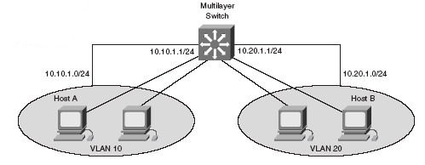
SVI-Based Inter-VLAN Routing Example
Switch(config)# ip routing
Switch(config)# router rip
Switch(config-router)# network 10.0.0.0
Switch(config)# interface vlan 10
Switch(config-if)# ip address 10.10.1.1 255.0.0.0
Switch(config-if)# no shutdown
Switch(config-if)# interface vlan 20
Switch(config-if)# ip address 10.20.1.1 255.255.255.0
Switch(config-if)# no shutdown
Notes:
The figure shows a multilayer switch providing inter-VLAN routing for VLAN 10 and VLAN 20. The example shows the configuration of IP routing on a Catalyst 3560 by creating VLAN interfaces and assigning IP addresses and subnet masks to the interfaces. In addition, RIP is enabled as the routing protocol.
SVI Autostate
By default, when an SVI is created and enabled, the line state of an SVI with multiple ports on a VLAN is in the up state when it meets these conditions:
The VLAN exists and is active in the VLAN database on the switch.
The VLAN interface exists and is not administratively down.
At least one Layer 2 (access or trunk) port exists on the switch, has a link in the up state on this VLAN, and is in the spanning-tree forwarding state on the VLAN.
The SVI interface is up when one Layer 2 port in that VLAN is in spanning-tree forwarding mode. When a VLAN has multiple ports, the default action is to take the SVI down as soon as all the ports belonging in the VLAN go down. This feature helps minimize problems such as routing black holes, which happens when a routing protocol uses VLAN interfaces and misinterprets a VLAN interface as fully operational if there is no interface up in that VLAN. In some cases, when a port connects to some monitoring equipment and intrusion prevention sensors, the port stays up because it is only connected to the monitoring equipment and because of that the VLAN interface stays up. The monitoring ports are not used for activating any data transfers like host ports, and it stays up most of the time. The switchport autostate exclude commands help in that scenario so that the VLAN goes down when all other ports in the VLAN (those connected to active hosts) go down except the ones configured with autostate exclude. The SVI autostate exclude feature configures a port so that it is not included in the SVI line-state up-and-down calculation and the SVI interface goes down if all others ports in that VLAN goes down, even if the ports configured with this feature stayed up. A network engineer would therefore need to carefully consider the implications of activating this feature on a trunk link.
To configure a Layer 2 switchport for autostate exclude, follow these two steps:
Step 1. Select an interface for configuration:
Switch(config)# interface interface_id
Step 2. Exclude the access port/trunk in defining the status of an SVI (up or down). This command would commonly be used for ports used for monitoring, for instance, so that a monitoring port did not cause the SVI to remain up when no other ports are active in the VLAN:
Switch(config-if)# switchport autostate exclude

Slide 10
Configuring Routed Ports
Step 1. Select the interface for configuration.
Switch(config)# interface interface-id
Step 2. Convert this port from a physical Layer 2 port to a physical Layer 3 interface.
Switch(config-if)# no switchport
Step 3. Configure the IP address and IP subnet mask. This address will be used by hosts on the segment connected to this interface for communication to the switch on this interface, or as the default gateway to other networks.
Switch(config-if)# ip address ip_address subnet_mask
Step 4. (Optional.) Enable IP routing on the router.
Switch(config)# ip routing
Step 5. (Optional.) Specify an IP routing protocol or use static routes:
Switch(config)# router ip_routing_protocol options
Notes:
To configure routed ports, make sure to configure the respective interface as a Layer 3 interface using the no switchport interface command, if the default configurations of the interfaces are Layer 2 interfaces as with the Catalyst 3560 family of switches. In addition, assign an IP address and other Layer 3 parameters as necessary. The rest of the steps are similar, as mentioned in the configuration of Inter-VLAN routing using SVI.
Note Entering the no switchport interface configuration command shuts down the interface and then reenables it, which might generate messages on the device to which the interface is connected. When you use this command to put the interface into Layer 3 mode, you delete any Layer 2 characteristics configured on the interface.

Slide 11
Routed Port Example
Switch(config)# interface GigabitEthernet 1/1
Switch(config-if)# no switchport
Switch(config-if)# ip address 10.10.1.1 255.255.255.252
Switch(config-if)# exit
Switch(config)# interface GigabitEthernet 1/2
Switch(config-if)# ip address 10.20.1.254 255.255.255.252
% IP addresses may not be configured on L2 links.
Switch(config-if)# no switchport
Switch(config-if)# ip address 10.20.1.254 255.255.255.252
Notes:
The example illustrates the configuration of routed ports for a Catalyst 3560 switch running Cisco IOS. In this example, if the port is a Layer 2 port, the switch returns an error message upon attempted configuration.

Slide 12
Common Inter-VLAN Routing Problems
Problem | Possible Cause
Missing VLAN | VLAN might not be defined across all the switches. VLAN might not be enabled on the trunk ports. Ports might not be in the right VLANs.
Layer 3 interface configuration | Virtual interface might have the wrong IP address or subnet mask. Virtual interface might not be up. Virtual interface number might not be match with the VLAN number. Routing has to be enabled to route frames between VLAN. Routing might not be enabled.
Routing protocol misconfiguration | Every interface or network needs to be added in the routing protocol. The new interface might not be added to the routing protocol. Routing protocol configuration is needed only if VLAN subnets needs to communicate to the other routers, as previously mentioned in this chapter.
Host misconfiguration | Host might not have the right IP or subnetmask. Each host has to have the default gateway that is the SVI or Layer 3 interface to communicate the other networks and VLAN. Host might not be configured with the default gateway.
Notes:
To troubleshoot inter-VLAN routing issues, the following are some checkpoint implementations:
Correct VLANs on switches and trunks.
Correct routes.
Correct primary and secondary root bridges.
Correct IP address and subnet masks.
Note You need to know on a particular VLAN that the IP addresses should be taken from the range used for the subnet/VLAN and that the mask should match; otherwise, the host and SVI—even though in the same VLAN—might not able to communicate because they are in the different networks.
To plan how to troubleshoot the inter-VLAN problems, you need to first understand the implementation and design layout of the topology before starting the troubleshooting.
Example of a Troubleshooting Plan
A company XYZ adding a new floor to the current network and based on this the current requirements are to make sure the users on the new floor 5 can communicate with users on other floors. The current issue is that users on floor 5 cannot communicate with user on the other floor. Following is the example of the implementation plan to install a new VLAN for their use and make sure it is routing to other VLANs. Your implementation plan lists the following steps:
Step 1. Create a new VLAN 500 on the fifth floor switch and on the distribution switches. Name it Accounting department.
Step 2. Identify the ports needed for the users and switches. Set the switchport access VLAN command to 500 and make sure the trunk is configured using the configuration mentioned in Chapter 2 between the switches and VLAN 500 is allowed on the trunk.
Step 3. Create an SVI interface on the distribution switches and make sure the IP address are assigned.
Step 4. Verify connectivity.
The troubleshooting plan might look like this:
If a new VLAN has been created:
Was the VLAN created on all the switches?
If VTP is configured, make sure VLANs are defined on the VTP server and are getting propagated across all the domains.
Verify with a show vlan command.
Make sure ports are in the right VLAN and trunking is working as expected:
Did all access ports get the command switchport access vlan 510 added?
Were there any other ports that should have been added? If so, make those
changes.
Were these ports previously used? If so, make sure there are no extra commands
enabled on these ports that can cause conflicts. If not, is the port enabled?
Are the access ports set to switchport access and not trunks? If not, issue the command switchport mode access.
Are the trunk ports set to trunk mode and manually prune all the VLAN.
Is manual pruning of VLANs a possibility? If so, make sure that the trunks necessary to carry this VLAN traffic have the VLAN in the allowed statements.
If SVI interfaces are created:
Is the VLAN virtual interface already created with the correct IP address and subnet mask? Is it enabled?
Is the routing enabled?
Is this SVI added in the routing protocol
Verify connectivity.
Are all the links between the different switches on the path enabling this VLAN to be transported?
Are all the links between switches in trunk mode?
Is this VLANs allowed on all trunks?
Is spanning-tree blocking one of those links?
Are the ports enabled?
Does the host have the right default gateway assigned.
Also make sure the default route or some routing protocol is enabled if it needs to talk to other routers.

Slide 13
Configuring Layer 3 EtherChannels
Step 1. Create a virtual Layer 2 interface.
Switch(config)# interface port-channel 1
Step 2. Convert to a Layer 3 interface to enable IP configuration.
Switch(config-if)# no switchport
Step 3. Assign an IP address to the port-channel interface:
Switch(config-if)# ip address ip_address subnet_mask
Step 4. Navigate to the interfaces that are to be associated with the EtherChannel bundle:
Switch(config)# interface range interface_id portnumber_range
Step 5. For a Layer 3 EtherChannel to form, the associated physical ports must be configured as Layer 3 ports. Assign the interfaces to the EtherChannel group:
Switch(config-if-range# no switchport
Switch(config-if-range)# channel-group channel-group-number mode {auto [non-silent] | desirable [non-silent] | on} | {active | passive}
Notes:
Make sure the channel mode is set up right on both sides. Depending on the mode, the EtherChannel can use LACP or PAgP (as discussed in Chapter 2).
Note It is important to match the EtherChannel configuration on both sides on the switches, and the IP addresses on the port-channel interfaces should be on the same subnets/VLAN to communicate.

Slide 14
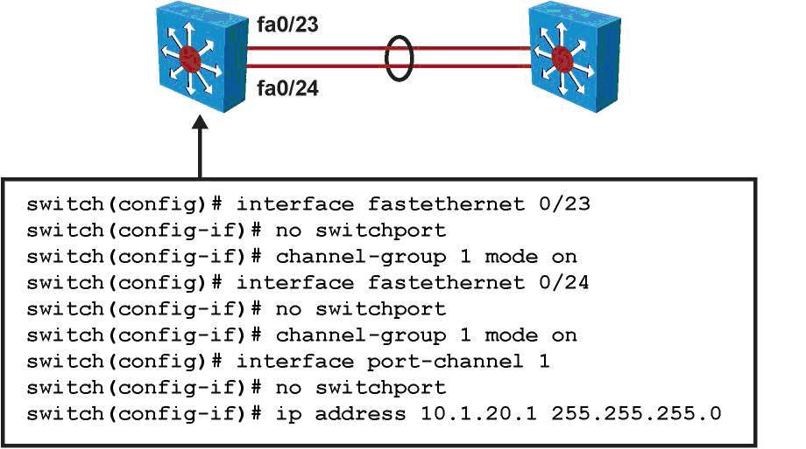
Layer 3 EtherChannel Example
Notes:
The figure shows a sample configuration for two switches using a Layer 3 EtherChannel bundle. The left switch has created a virtual interface with an IP address, and the physical interfaces are assigned to the matching channel-group number. The same is true with the right switch. Again, the virtual port-channel interfaces do not need to have the same number as any of the partner switches.
The following guidelines are followed to create the Layer 3 EtherChannel:
Speed and duplex: Configure all interfaces in an EtherChannel to operate at the same speed and in the same duplex mode.
Interface mode: As the port-channel interface is a routed port, the no switchport command was applied to it. The physical interfaces are by default switched, which is a mode incompatible with a router port. This is why the no switchport command was also applied to the physical ports, to make their mode compatible with the EtherChannel interface mode.
Layer 3 configuration: Ensure the two switches connected using Layer 3 EtherChannel are configured with the IP addresses belonging to the same VLAN subnet with the correct subnet mask.
Verifying the EtherChannel configuration: After EtherChannel is configured, use the following commands to verify and troubleshoot EtherChannel:
show interface port-channel channel-group-number
show etherChannel channel-group-number summary
show spanning-tree vlan vlan-number detail
Note This chapter discusses only the configuration for Layer 3 port-channel. The concepts of EtherChannel and Layer 2 EtherChannel configuration are discussed in detail in Chapter 2.

Slide 15
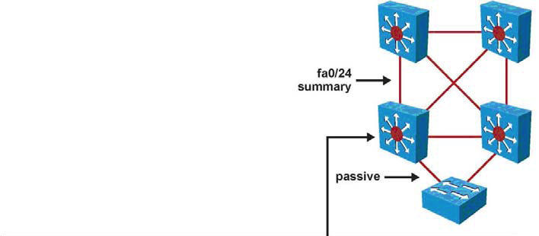
Routing Protocol Configuration
Switch(config)# ip routing
Switch(config)# router eigrp 100
Switch(config-router)# no auto-summary
Switch(config-router)# network 10.0.0.0
Switch(config-router)# passive-interface default
Switch(config-router)# no passive-interface fa0/24
Switch(config)# interface fa0/24
Switch(config-if)# description Uplink
Switch(config-if)# ip summary-address eigrp 100 10.1.0.0 255.255.240.0
Notes:
Routing Protocol Configuration
As soon as a multilayer switch is configured with Layer 3 IP addresses, it starts behaving like a router in the sense that it has connections to different subnets. Communication between these subnets can no longer be achieved using Layer 2 protocols. A major difference between a multilayer switch and a router is that a multilayer switch does not route until some Layer 3 or SVI interfaces are created. When routing is enabled, the network administrator configures static routes and dynamic routing, just like on a router, as shown in the figure. Here EIGRP is configured. Notice the passive interface commands. On a Layer 3 switch, a common recommendation is to enable dynamic routing only on those interfaces that need to exchange routing information with neighbors. Wherever needed, summarization should also be configured to limit the size of the routing tables.

Slide 16
Multilayer Switch Processing
Combines functionality of switch and router
Offloads software-based routing process (packet rewrite) to specialized ASIC hardware
Provides wire-speed Ethernet routing and switching services
Optimized for campus LAN
Performs three major functions:
Packet switching
Route processing
Intelligent network services

Slide 17
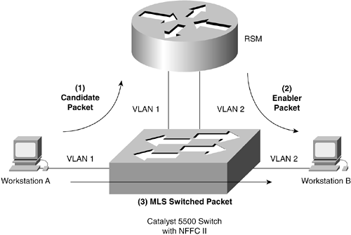
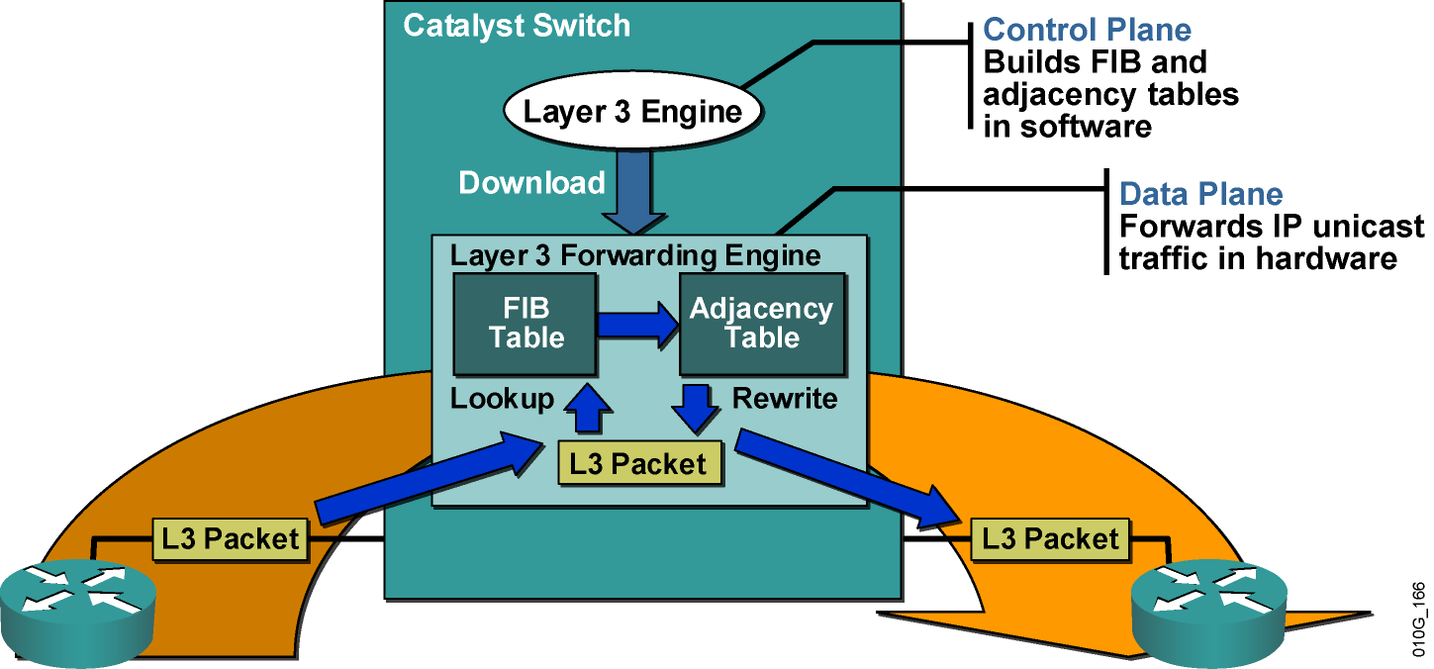
Multilayer Switching
Traditional MLS
CEF-Based MLS
Multilayer switching - ability of a Catalyst switch to support switching and routing of packets in hardware.
Optional support for Layers 4 through 7 switching in hardware as well.
Hardware switching: A route processor (Layer 3 engine) must download software-based routing, switching, access lists, QoS, and other information to the hardware for packet processing.
Notes:
Multilayer switching refers to the ability of a Catalyst switch to support switching and routing of packets in hardware, with optional support for Layers 4 through 7 switching in hardware as well.
Hardware switching: A route processor (Layer 3 engine) must download software-based routing, switching, access lists, QoS, and other information to the hardware for packet processing.
Most enterprise networks use multilayer switches to achieve high packet-processing rates using hardware switching.
Multilayer (layer 3) switches usually have packet-switching throughputs in the millions of packets per second (pps), whereas traditional general-purpose routers provide packet switching in the range of 100,000 pps to just over 1 million pps.

Slide 18
CEF-based MLS

Slide 19
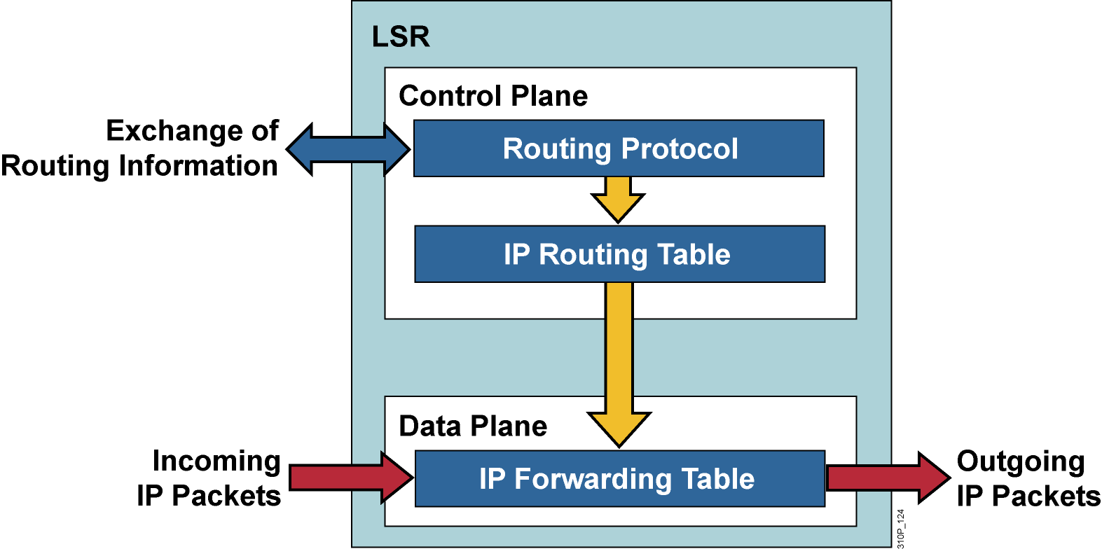
CEF
CEF-based MLS forwarding model is used to download the control plane information such as the access lists to the data plane on the supervisor, port, or line card for hardware switching of packets.
Control plane represents the Layer 3 engine (route processor)
Data plane represents the hardware components such as ASICs used by the switch for hardware switching.
CEF is a topology-based forwarding model in which all routing information is prepopulated into a forwarding information base (FIB).
Result is switches can quickly look up routing information such as IP adjacencies and next-hop IP and MAC addresses.
Notes:
CEF-based MLS forwarding model is used to download the control plane information such as the access lists to the data plane on the supervisor, port, or line card for hardware switching of packets.
Control plane represents the Layer 3 engine (route processor)
Data plane represents the hardware components such as ASICs used by the switch for hardware switching.
CEF is a topology-based forwarding model in which all routing information is prepopulated into a forwarding information base (FIB).
As a result of the prepopulation of routing information, Catalyst switches can quickly look up routing information such as IP adjacencies and next-hop IP and MAC addresses.

Slide 20
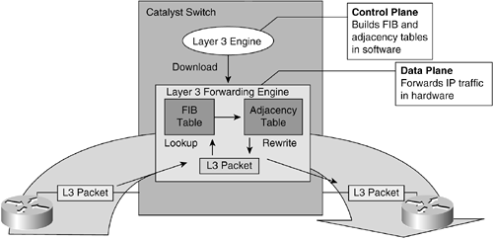


CEF
Routing Table
The two main components of CEF are :
FIB
Adjacency Table
Forwarding information base
Make IP destination switching decisions.
Similar to a routing table
Mirror image of the forwarding information contained in the IP routing table.
When routing or topology changes occur in the network, the IP routing table is updated, and those changes are reflected in the FIB.
Maintains next-hop address information based on the information in the IP routing table.
Both the Layer 3 engine and the hardware-switching components maintain a FIB.
Notes:
The two main components of CEF are FIB and Adjacency Table
Forwarding information base
Used make IP destination prefix-based switching decisions.
Similar to a routing table or information base.
It maintains a mirror image of the forwarding information contained in the IP routing table.
When routing or topology changes occur in the network, the IP routing table is updated, and those changes are reflected in the FIB.
The FIB maintains next-hop address information based on the information in the IP routing table.
In the context of CEF-based MLS, both the Layer 3 engine and the hardware-switching components maintain an FIB.

Slide 21
CEF
Adjacency tables
Network nodes in the network are said to be adjacent if they can reach each other with a single hop across a link layer. (OSPF, EIGRP)
A router normally maintains:
Routing table containing Layer 3 network and next-hop information
ARP table containing Layer 3 to Layer 2 address mapping.
These tables are kept independently.
Notes:
Adjacency tables
Network nodes in the network are said to be adjacent if they can reach each other with a single hop across a link layer. (OSPF, EIGRP)
A router normally maintains:
Routing table containing Layer 3 network and next-hop information
ARP table containing Layer 3 to Layer 2 address mapping.
These tables are kept independently.

Slide 22
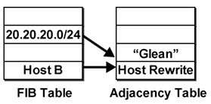
CEF
Layer 2 MAC Addresses, Next Hop Information
Next hop?
Adjacency tables
The FIB keeps the Layer 3 next-hop address for each entry.
To streamline packet forwarding even more, the FIB has corresponding Layer 2 information for every next-hop entry.
This portion of the FIB is called the adjacency table, consisting of the MAC addresses of nodes that can be reached in a single Layer 2 hop.
Notes:
Adjacency tables
Recall that the FIB keeps the Layer 3 next-hop address for each entry.
To streamline packet forwarding even more, the FIB has corresponding Layer 2 information for every next-hop entry.
This portion of the FIB is called the adjacency table, consisting of the MAC addresses of nodes that can be reached in a single Layer 2 hop.

Slide 23
CEF
No ARP entry, L3 forwarding engine can’t forward packet in hardware, must send to L3 Engine.
I’ll generate the ARP Request and get an ARP Reply.
Adjacency tables
Built from the ARP table.
As a next-hop address receives a valid ARP entry, the adjacency table is updated.
If an ARP entry does not exist, the FIB entry is marked as “CEF glean.”
This means that the Layer 3 forwarding engine can't forward the packet in hardware, due to the missing Layer 2 next-hop address.
The packet is sent to the Layer 3 engine so that it can generate an ARP request and receive an ARP reply.
This is known as the “CEF glean” state, where the Layer 3 engine must glean the next-hop destination's MAC address.
Notes:
Adjacency tables (summary, more detail coming)
The adjacency table information is built from the ARP table.
As a next-hop address receives a valid ARP entry, the adjacency table is updated.
If an ARP entry does not exist, the FIB entry is marked as “CEF glean.”
This means that the Layer 3 forwarding engine can't forward the packet in hardware, due to the missing Layer 2 next-hop address.
The packet is sent to the Layer 3 engine so that it can generate an ARP request and receive an ARP reply.
This is known as the “CEF glean” state, where the Layer 3 engine must glean the next-hop destination's MAC address.

Slide 24
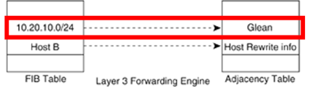
CEF
Adjacency tables
What happens to subsequent packets while FIB entry is in glean state? (L3 engine is sending ARP Request.)
These packets are dropped.
So input queues do not fill.
So Layer 3 engine does not become too busy worrying about the need for duplicate ARP requests.
This is called ARP throttling or throttling adjacency.
If an ARP reply is not received in two seconds, the throttling is released so that another ARP request can be triggered.
After ARP reply is received:
Throttling is released
FIB entry can be completed
Subsequent packets can be forwarded in hardware
Notes:
Adjacency tables
During the time that a FIB entry is in the CEF glean state waiting for the ARP resolution, subsequent packets to that host are immediately dropped so that the input queues do not fill and the Layer 3 engine does not become too busy worrying about the need for duplicate ARP requests.
This is called ARP throttling or throttling adjacency.
If an ARP reply is not received in two seconds, the throttling is released so that another ARP request can be triggered.
Otherwise, after an ARP reply is received, the throttling is released, the FIB entry can be completed, and packets can be forwarded completely in hardware.
When a router is directly connected to a multiaccess segment (Ethernet), the router maintains an additional prefix for the subnet..
This subnet prefix points to a glean adjacency.
When a router receives a packets that needs to be forwarded to a specific host, the adjacency database is gleaned for a specific prefix.
If the prefix does not exist, the subnet prefix is consulted.
The glean adjacency indicates that any address with this range should be forwarded to the Layer 3 engine ARP processing.

Slide 25
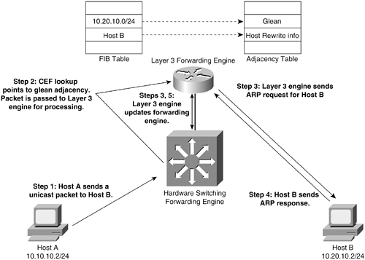
ARP Throttling
1. Host A sends a packet to Host B.
CEF lookup shows glean adjacency (ARP entry does not exist so no entry in adjacency table).
No rewrite information exists.
2. Packet passed to Layer 3 Engine for processing.
Notes:
1. Host A sends a packet to Host B.
CEF lookup shows glean adjacency (ARP entry does not exist so no entry in adjacency table).
No rewrite information exists.
2. Packet passed to Layer 3 Engine for processing.

Slide 26
ARP Throttling
Throttling Adjacency is removed when no ARP Reply is received in 2 seconds. This allows for another packet to to initiate a new ARP Request.
Throttling Adjacency relieves the Layer 3 Engine of excessive ARP processing or ARP-based DoS attacks.
Drop packets until ARP Reply received (Throttling Adjacency)
ARP Request
X
X
X
3. Obtaining rewrite information.
L3 Engine sends an ARP Request for Host B and waits for ARP Reply.
Throttling Adjacency: While in glean state, subsequent packets to that host are dropped, so that input queues do not fill and so the Layer 3 engine isn’t busy with duplicate ARP Requests.
Notes:
3. Obtaining rewrite information.
L3 Engine sends an ARP Request for Host B and waits for ARP Reply.
Throttling Adjacency: While in glean state, subsequent packets to that host are dropped, so that input queues do not fill and so the Layer 3 engine isn’t busy with duplicate ARP Requests. (Note: Cisco’s routers drop the first packet when there is no ARP entry, while sending the ARP Request.)
Throttling Adjacency is removed when no ARP Reply is received in 2 seconds. This allows for another packet to to initiate a new ARP Request.
Throttling Adjacency relieves the Layer 3 Engine of excessive ARP processing or ARP-based DoS attacks.

Slide 27
ARP Throttling
Drop packets until ARP Reply received (Throttling Adjacency)
ARP Reply
X
X
X
4. Host B sends ARP Reply.
Notes:
4. Host B sends ARP Reply

Slide 28
ARP Throttling
Host B’s MAC Address
10.20.10.2
Drop packets until ARP Reply received (Throttling Adjacency)
5. The Layer 3 Engine installs Adjacency for Host B and removes the throttling (drop) adjacency.
Next: Packet Rewrite (Coming!)
Notes:
5. The Layer 3 Engine installs Adjacency for Host B and removes the throttling (drop) adjacency.
Next: Packet Rewrite (Coming!)

Slide 29
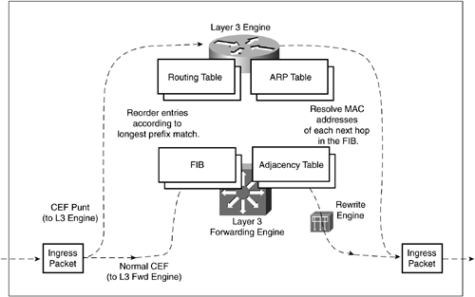
Packet Rewrite
Egress Packet

Slide 30
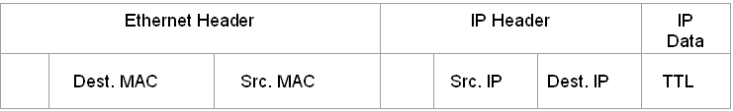
Packet Rewrite
Host B’s MAC Address
10.20.10.2
L2 Checksum
L3 Checksum
Default Gateway
Host A
TTL
The switch receives another packet:
After a multilayer switch finds valid entries in the FIB and adjacency tables, a packet is almost ready to be forwarded.
One step remains—the packet header information must be rewritten.
Multilayer switching occurs as quick table lookups:
Find the next-hop address
Outbound switch port.
The IP header must also be adjusted, as if a traditional router had done the forwarding (TTL).
Notes:
The switch receives another packet:
After a multilayer switch finds valid entries in the FIB and adjacency tables, a packet is almost ready to be forwarded.
One step remains—the packet header information must be rewritten.
Keep in mind that multilayer switching occurs as quick table lookups, to find the next-hop address and the outbound switch port.
The packet is untouched, still having the original destination MAC address of the switch (Router interface) itself.
The IP header must also be adjusted, as if a traditional router had done the forwarding (TTL).

Slide 31

Packet Rewrite
Host B’s MAC Address
10.20.10.2
L2 Checksum
L2 Checksum
L3 Checksum
L3 Checksum
TTL
Default Gateway
TTL - 1
Host B MAC Add
Host A
L3 switch outbound interface
The packet rewrite engine makes the following changes to the packet just prior to forwarding:
Layer 2 destination address— Changed to the next-hop device's MAC address
Layer 2 source address— Changed to the outbound Layer 3 switch interface's MAC address
Layer 3 IP Time To Live (TTL)— Decremented by one, as one router hop has just occurred
Layer 2 frame checksum— Recalculated to include changes to the Layer 2 and Layer 3 headers
Layer 3 IP checksum— Recalculated to include changes to the IP header
Notes:
The packet rewrite engine makes the following changes to the packet just prior to forwarding:
Layer 2 destination address— Changed to the next-hop device's MAC address
Layer 2 source address— Changed to the outbound Layer 3 switch interface's MAC address
Layer 3 IP Time To Live (TTL)— Decremented by one, as one router hop has just occurred
Layer 3 IP checksum— Recalculated to include changes to the IP header
Layer 2 frame checksum— Recalculated to include changes to the Layer 2 and Layer 3 headers

Slide 32
Packet Rewrite
Host B’s MAC Address
10.20.10.2
L2 Checksum
L2 Checksum
L3 Checksum
L3 Checksum
TTL
Default Gateway
TTL - 1
Host B MAC Add
Host A
L3 switch outbound interface
A traditional router would normally make the same changes to each packet.
The multilayer switch must act as if a traditional router were being used, making identical changes.
The multilayer switch:
Can do this very efficiently with dedicated packet rewrite hardware and with address information obtained from table lookups.
Notes:
A traditional router would normally make the same changes to each packet.
The multilayer switch must act as if a traditional router were being used, making identical changes.
However, the multilayer switch can do this very efficiently with dedicated packet rewrite hardware and address information obtained from table lookups.

Slide 33
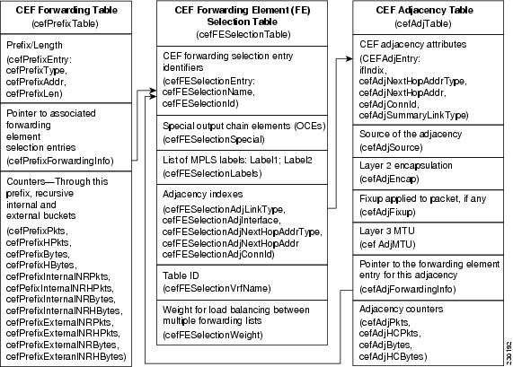
Packet Rewrite
Host B’s MAC Address
10.20.10.2
L2 Checksum
L2 Checksum
L3 Checksum
L3 Checksum
TTL
Default Gateway
TTL - 1
Host B MAC Add
Host A
L3 switch outbound interface
The switch performs a Layer 3 lookup and finds a CEF entry for Host B.
The switch rewrites packets per the adjacency information and forwards the packet to Host B on its VLAN.
Notes:
The switch performs a Layer 3 lookup and finds a CEF entry for Host B.
The switch rewrites packets per the adjacency information and forwards the packet to Host B on its VLAN.

Slide 34
Enabling CEF
The commands required to enable CEF are platform dependent:
On the Cisco Catalyst 4000 switch
Switch(config-if)#ip cef
On the Cisco Catalyst 3550 switch
Switch(config-if)#ip route-cache cef
Verifying CEF
Switch#show ip cef [type mod/port | vlan_interface] [detail]
Notes:
Configuring CEF
ip cef (enabled by default)
ip route-cache cef (only on VLAN interface)
Verifying CEF
show ip cef fa 0/1 detail
show adjacency fa 0/1 detail

